Slide 1
Chapter One
“Limits and Continuity”:

Slide 2
All graphics are attributed to:
Calculus,10/E by Howard Anton, Irl Bivens, and Stephen Davis Copyright © 2009 by John Wiley & Sons, Inc. All rights reserved.

Slide 3
Summary
The concept of a “limit” is the fundamental building block on which all calculus concepts are based.
We study limits informally, with the goal of developing an intuitive feel for the basic ideas.
We will also focus on computational methods and precise definitions.

Slide 4
Geometric problems leading to limits

Slide 5
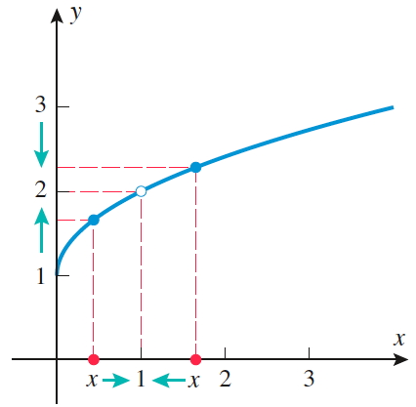
limits
The most basic use of limits is to describe how a function behaves as x (the independent variable) approaches a given value.
In this figure, as x gets
closer and closer to 1
from either the left or
the right, y values get
closer and closer to 2.

Slide 6
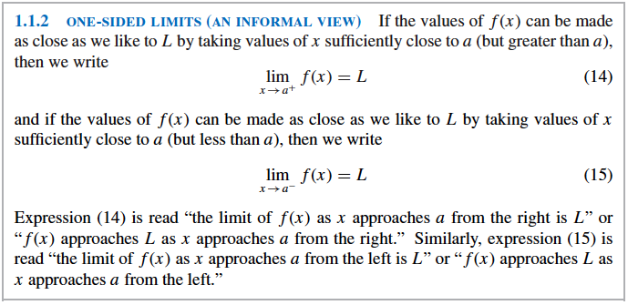
Terminology
We can find one sided or two sided limits. Below is the notation for one sided limits.

Slide 7
One sided limits examples

Slide 8
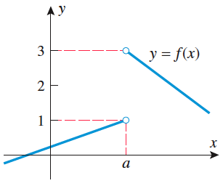
The Relationship Between One-Sided and Two-Sided Limits
Therefore, the two sided limit at a
does not exist for the figure on
the right because its one sided
limits are not equal (1 does
not equal 3).

Slide 9
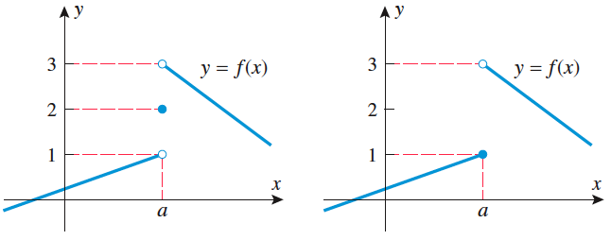
“as you approach” not at
All of these graphs have the same one sided limits and none of the two sided limits exist. It does not matter what happens right at the a value when determining limits.

Slide 10
Infinite limits
Sometimes one-sided or two-sided limits fail to exist because the values of the function increase or decrease without bound.
Positive and negative infinity (on the next slide are not real numbers), they simply describe particular ways in which the limits fail to exist.
You cannot manipulate infinity algebraically (you cannot add, subtract, etc).

Slide 11
Infinite limits example

Slide 12
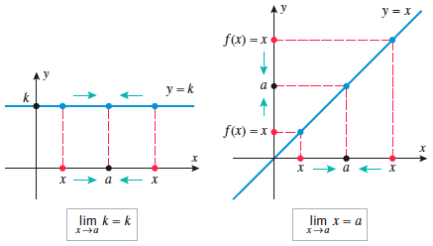
Some basic limits
The limit of a constant = that constant because the y value never changes. (1.2.1 a)
The limit of y=x as x approaches any value is just that value since x and y are equal.(1.2.1b)

Slide 13
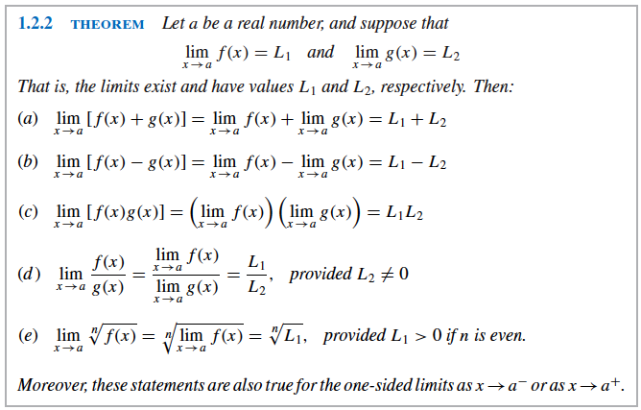
Basic tool for finding limits algebraically
These look terrible, but I will explain them on the next slide and give examples after that.

Slide 14
Indeterminate form of type 0/0
The following example is called indeterminate form of type 0/0 because if you do jump directly to substitution, you will get 0/0.

Slide 15
More indeterminate form
Sometimes, limits of indeterminate forms of type 0/0 can be found by algebraic simplification, as in the last example, but frequently this will not work and other methods must be used.
One example of another method involves multiplying by the conjugate of the denominator (see example on next page).

Slide 16
example

Slide 17
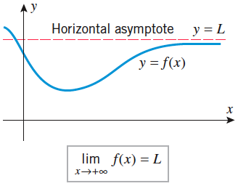
Limits at infinity and horizontal asymptotes
We discussed infinite limits briefly on slides 12 & 13 in section 1.3.
We will now expand our look at situations when the value of x increases or decreases without bound (“end behavior”) and as a function approaches a horizontal asymptote.
Below is a picture of a function with a horizontal asymptote and a related limit.
The further you follow the
graph to the right, the closer
y values get to the asymptote.
That is why the limit is L.

Slide 18
Example #1

Slide 19
Example 2

Slide 20
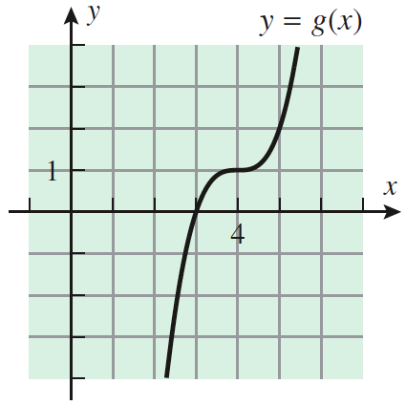
Limits of polynomials as x approaches +/- infinity
The end behavior of a polynomial matches the end behavior of its highest degree term.
From the Lead Coefficient Test (+1) and the degree (odd), we know that the end behavior of y= x³ is down up, therefore, the same must be true for y = x³-12x²+48x-63 which is g(x)=(x-4)³+1 in graphing form.
The graph of g(x) on the right
does fall to the left and rise to the
right, just as end behavior predicts.

Slide 21
Higher degree example

Slide 22
Limits of rational functions as x approaches +/- infinity
One technique for determining the end behavior of a rational function is to divide each term in the numerator and denominator by the highest power of x that occurs in the denominator, then follow methods we already know.
Example:

Slide 23
introduction
A thrown baseball cannot vanish at some point and reappear someplace else to continue its motion. Thus, we perceive the path of the ball as an unbroken curve. In this section, we will define “unbroken curve” to mean continuous and include properties of continuous curves.

Slide 24
Definition of continuity
#1 means that there cannot be an unfilled hole remaining at that value (c) where you are finding the limit.
#2 means that the two one sided limits must be equal.
#3 means that the limit and the point at that value (c) must be equal.

Slide 25
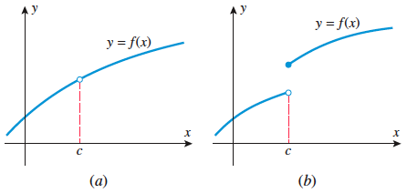
Graphing examples that are not continuous
(a) has a hole, so it breaks rule #1.
(b) has a limit that does not exist (DNE) at c because the two sided limits are not equal, so it breaks rule #2.

Slide 26
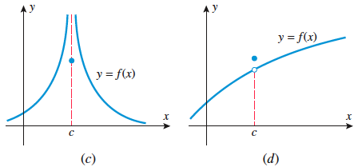
More graphing examples
(c) & (d) both break rule #3. The two sided limit does exist, and it is defined at c, but the two values are not equal so they are not continuous.

Slide 27
Function example

Slide 28
Continuity on an interval
Continuity on an interval just means that we are testing for continuity only on a certain part of the graph, and the rules are very similar to the ones previously listed. You just have to be careful around the ends of the interval. See example 2 on page 112.

Slide 29
Continuity of polynomials, rational functions, and absolute value
Polynomials are continuous everywhere because their graphs are always smooth unbroken curves with no jumps breaks or holes which go on forever to the right and to the left.
Rational functions are continuous at every point where the denominator is not zero because they are made up of polynomial functions which are continuous everywhere, but one cannot divide by zero. Therefore, they are only discontinuous where the denominator is zero.
The absolute value of a continuous function is continuous.

Slide 30
Example of a rational function
I think you already know this, but it is worth making sure.
Example:

Slide 31
Continuity of compositions
A limit symbol can be moved through a function sign as long as the limit of the inner function exists and is continuous where you are calculating the limit.
Example:

Slide 32
The intermediate-value theorem
We discussed this some last year, and we will continue to discuss it. It is more obvious than the theorem sounds.
Often used to find the zeros of a function.

Slide 33
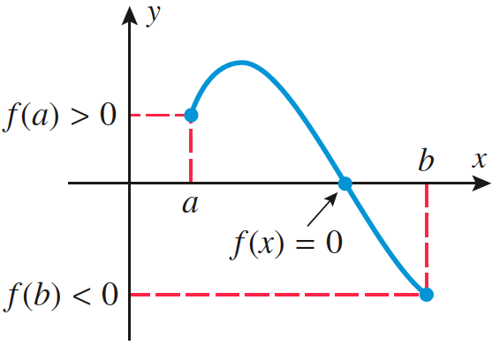
The intermediate-value theorem graphically
If two x values have different signs and the function is continuous (no jumps breaks or homes), then there will be a root/zero/x-intercept somewhere between those x values.

Slide 34
Continuity of trigonometric functions
sin x and cos x are continuous everywhere.
tan x, cot x, csc x, and sec x are continuous everywhere except at their asymptotes.
Therefore, sin ⁻¹ x, cos ⁻¹ x, and tan ⁻¹ x are only continuous on their own domains which are (–π/2, π/2) for sin ⁻¹ x and tan ⁻¹ x and (0,π) for cos ⁻¹ x.

Slide 35
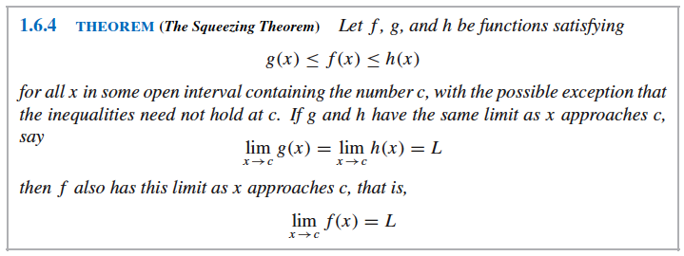
The squeezing theorem
Theorem 1.6.5 on a later slide will give you the two most common uses.

Slide 36
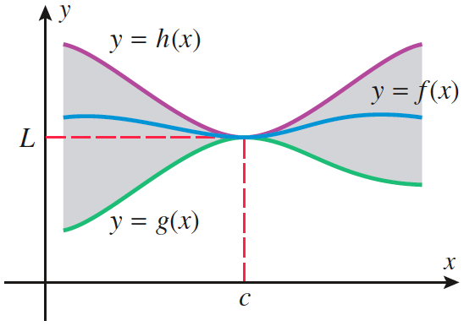
Squeezing theorem graphically
There is no easy way to calculate some indeterminate type 0/0 limits algebraically so, for now, we will squeeze the function between two known functions to find its limit like in the graph below.

Slide 37
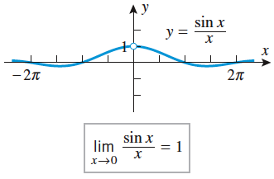
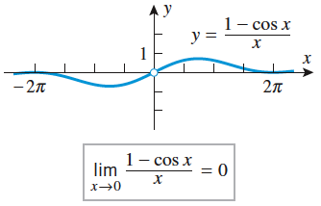
Common uses this year
These are the most common applications of the squeezing theorem for the first Calculus course.
They may make more sense if you look at their graphs and find the limits that way.

Slide 38
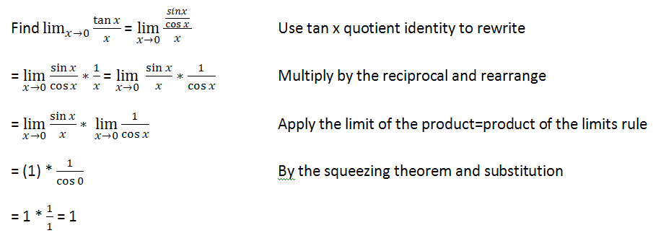
Proofs and examples
Theorem 1.6.5 is proven on page 123 if you are interested in how it works.
Example 1 of how it is used:

Slide 39
Another example
Example 2:

Slide 40
Strategies for calculating limits
Graph
Substitution
Simplify, then substitute
Multiply numerator and denominator by conjugate of the denominator, then follow with step 3.
Analyze end behavior
Divide each term in the numerator and denominator by the highest power of x that occurs in the denominator, then follow with other steps.
Squeezing Theorems

